Slide 1

Lecture 8-10
Organic Chemistry: Fundamentals and Applications (CSO201A)
Dr. Srinivas Dharavath
Assistant Professor
Department of Chemistry
Indian Institute of Technology, Kanpur
Kanpur- 208016
E-mail: srinivasd@iitk.ac.in

Slide 2

NOMENCLATURE OF HETEROCYCLIC COMPOUND

Slide 3

The IUPAC rules allow three nomenclatures
Common Names
II. The Replacement Nomenclature
III. The Hantzsch-Widman Nomenclature

Slide 4

I-Common Nomenclature
Each compound is given the corresponding trivial name. This usually originates from the compounds occurrence, its first preparation or its special properties.
If there is more than one hetero atom of the same type numbering starts at the saturated one,
e.g. imidazole.
If there is more than one type of the hetero atoms, the ring is numbered starting at the hetero atom of the higher priority ( O>S>N ) and it continues in the direction to give the other hetero atoms the lower numbers as possible.

Slide 5

I-Common Nomenclature
If substituents present, their position should be identified by the number of the atoms bearing them and then they should be listed in alphabetical order.
5-Amino-4-bromoisoxazole
The words dihydro or trihydro or tetrahydro are used if two or three or four atoms are saturated. These words are preceded by numbers indicate the position of saturated atoms as low as possible and followed by the corresponding fully unsaturated trivial name.
1,2-Dihydro-pyridine

Slide 6

I-Common Nomenclature
5-membered heterocycles with one or two heteroatoms
Furan
Thiophene
Pyrrole
Imidazole
Pyrazole
Isoxazole
Oxazole
Thiazole

Slide 7

I-Common Nomenclature
6-membered heterocycles with one or two heteroatoms
2H-Pyran
4H-Pyran
Pyridine
These are tautomer's Both are not aromatic
Pyridazine
Pyrimidine
DNA/RNA bases
Pyrazine

Slide 8

I-Common Nomenclature
Fused heterocycles
Indole
Isoindole
Indazole
Purine
Indolizidine
Guanine

Slide 9

I-Common Nomenclature
Fused heterocycles
Quinoline
Isoquinoline
Quinazoline
Pteridine
Quinolizidine

Slide 10

I-Common Nomenclature
Saturated heterocycles
Pyrrolidine
Piperidine
Piperazine
Morpholine

Slide 11

II-Replacement nomenclature
Heterocycle’s name is composed of the corresponding carbocycle’s name and an elemental prefix for the hetero atom introduced, If more than one hetero atom is present they should be listed according to the priority order shown in table
Notice that heterocyclic rings are numbered so that the heteroatom has the lowest possible number.
ATOM | PREFIX
O | Oxa
S | Thia
Se | selena
N | Aza
P | Phospha
PRIORITY
DECREASE

Slide 12

II-Replacement nomenclature
Benzene
1,4-Diazabenzene
Cyclopentadiene
Oxacyclopenta-2,4-diene
Cyclopentadiene
1-Oxa-3-azacyclopenta-2,4-diene
Cyclopentadiene
1-Thia-2-azacyclopenta-2,4-diene

Slide 13

II-Replacement nomenclature
Cyclopropane
Oxacyclopropane
Cyclopropene
Oxazacyclopropene
Cyclohexane
1-Oxa-4-azacyclohexane
Naphthalene
2-Azanaphthalene

Slide 14

III. Hantzsch-Widman Nomenclature
n = 1,2,3, ……
German chemists Arthur Hantzsch and Oskar Widman, proposed similar systematic naming of heterocyclic compounds in 1887 and 1888 respectively
The Hantzsch-Widman nomenclature is based on the type (Z) of the heteroatom; the ring size (n) and nature of the ring, whether it is saturated or unsaturated.
This system of nomenclature applies to monocyclic three-to-ten-membered ring heterocycles.

Slide 15

Hantzsch-Widman rules for fully saturated and fully unsaturated heterocycles
IUPAC name = locants+ prefix +suffix
Identify the hetro atom present in the ring and choose from the corresponding prefix
ATOM | PREFIX
O | Oxa
S | Thia
Se | selena
N | Aza
P | Phospha
PRIORITY
DECREASE

Slide 16

Hantzsch-Widman RULE
The position of a single heteroatom control the numbering in a monocyclic compound. The heteroatom is always assigned position 1 and if substituents present are then counted around the ring in a manner so as to take the lowest possible numbers.
For example,
A multiplicative prefix (di, tri, etc.) and locants are used when two or more similar heteroatoms contained in the ring( two nitrogen indicated by di aza) and the numbering preferably commenced at a saturated rather than an unsaturated atom, as depicted in the following
For example, 1,3- diaza….

Slide 17

Hantzsch-Widman RULE
If more than one type of hetero atoms present in the ring the name will include more than one prefix with locants to indicate the relative position of the heteroatoms.
When combining the prefixes (e.g. oxa and aza) two vowels may end up together, therefore the vowel on the end of the first part should be omitted ( oxaza ).
The numbering is started from the hetero atom of the highest priority in such a way so as to give the smallest possible numbers to the other hetero atoms in the ring (the substituents are irrelevant). For example the prefix corresponding to the following compound is 4-Methyl-1,3-thiaza….

Slide 18
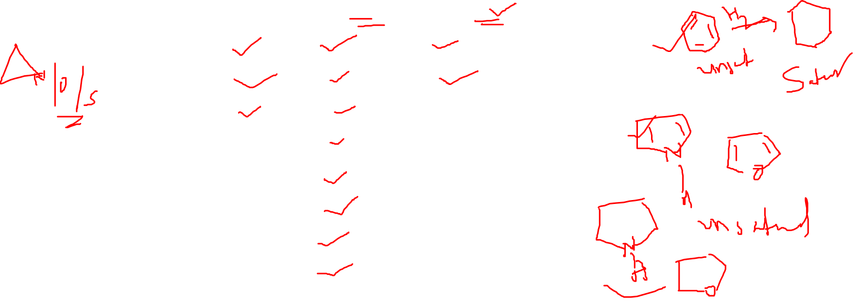
Hantzsch-Widman RULE
Choose the appropriate suffix from depending on whether or not nitrogen atom is present in the ring, the size of the ring and presence or absence of any double bonds
N PRESENT
Ring size
3
4
5
6
7
8
9
10
Unsat | Sat
Irine | Iridine
Ete | Etidine
ole | olidine
Ine | A
Epine | A
Ocine | A
Onine | A
Ecine | A

Slide 19

Hantzsch-Widman RULE
Combine the prefix(s) and suffix together and drop the first Hantzsch -Widman rules vowel if two vowels came together.
For example,
This ring contains N, Prefix is aza
The ring is 3-membered and fully saturated, suffix is iridine
By combining the prefix and suffix, two vowels ended up together (azairidine), therefore the vowel on the end of the first part should be dropped.
This gives the correctname: Aziridine

Slide 20

Hantzsch-Widman RULE
For example,
This ring contains O, prefix 1 ( oxa ), and two N prefix 2 ( diaza )
Locants, since (O) is higher priority than (N) so it is in position 1 by default and the two (N) are therefore at positions 2 and 5, this gives the combined prefixes as 1,2,5-oxadiaza (note that the a in oxa is not dropped)
It is 5-membered,fully unsaturated ring with (N) the suffix is ole
By combining the prefixes and the suffix and dropping the appropriate vowels we get the correct nameas 1,2,5-Oxadiazole

Slide 21

Hantzsch-Widman RULE
For example,
This ring contains O, N and O has higher priority than N and by Prefix is 1,2-Oxaaza,
But the starting numbering the ring at O first vowel must be omitted to give 1,2-Oxaza
The ring is 4-membered and fully saturated, suffix is etidine
By combining the prefix and suffix, two vowels ended up together 1,2 oaxazaetidine, therefore the vowel on the end of the first part should be dropped.
This gives the correct name: 1,2-oxazetidine

Slide 22

Hantzsch-Widman RULE
For example,
The ring is 6-memberd, fully saturated with N, Prefix perhydro
followed by the name of fully unsaturated 6-memberd ring with nitrogen azine
Thus the full name is perhydroazine

Slide 23

Hantzsch -Widman for partially unsaturated heterocycles
Partial unsaturation in heterocyclic compounds can be indicated by one of the following methods:
The position of nitrogen or carbon atoms which bear extra hydrogen atoms must be indicated by numbers and italic capital H ( e.g.1H, 2H, etc.) followed by the name of maximally unsaturated ring.
2H,3H-Oxole
1H-Azepine
5H-1,2,3-Oxathiazole
4H-Oxin

Slide 24

Hantzsch -Widman for partially unsaturated heterocycles
The words dihydro, trihydro or tetrahydro are used if two or three or four atoms are saturated. These words are preceded by numbers indicate the position of saturated atoms as low as possible and followed by the corresponding fully unsaturated Hantzsch-Widman name.
1,2-Dihydroazine
1,4-Dihydroazine
2,3,4,5-Tetrahydroazine
2,3-Dihydroxole

Slide 25

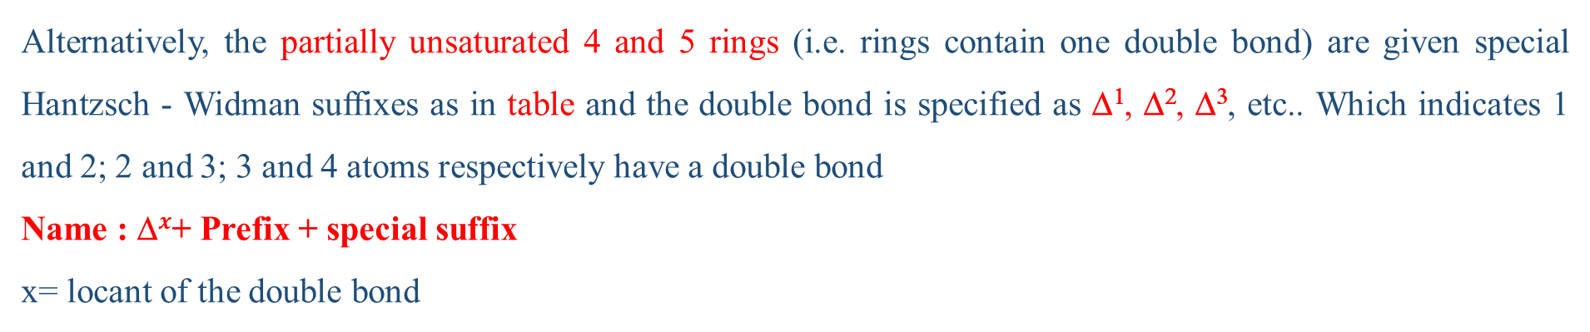
Hantzsch -Widman for partially unsaturated heterocycles
Alternatively, the partially unsaturated 4 and 5 rings (i.e. rings contain one double bond) are given special Hantzsch - Widman suffixes as in table and the double bond is specified as $\text{}\text{1}$, $\text{}\text{2}$, $\text{}\text{3}$, etc.. Which indicates 1 and 2; 2 and 3; 3 and 4 atoms respectively have a double bond
Name : $\text{}x$+ Prefix + special suffix
x= locant of the double bond
Ring Size
N Present
N Absent
4
5
-etine | -etene
-oline | -olene

Slide 26
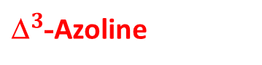
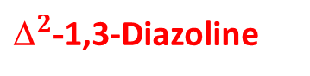
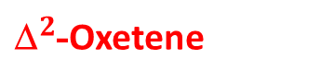

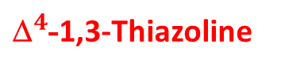

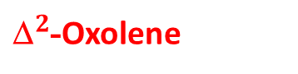
Hantzsch -Widman for partially unsaturated heterocycles
For example,
${\text{}}^{2}$-Azetine
${\text{}}^{2}$-Oxetene
${\text{}}^{3}$-Azoline
${\text{}}^{2}$-Oxolene
${\text{}}^{4}$-1,3-Thiazoline
${\text{}}^{2}$-1,3-Diazoline

Slide 27

Heterocyclic Nomenclature of Fused Systems
Fusion: This term is used to describe the process of joining two separate rings with the maximum number of non-cumulative double bonds via two atoms and one common bond.
Ortho-fused rings: are those rings that have only two common atoms and one bond, example; naphthalene
Ortho-and peri-fused rings: are those found in a polycyclic compound with a ring that is ortho- fused to different sides of two other rings that are themselves ortho-fused together (i.e. there are three common atoms between the first ring and the other two).
Napthalene

Slide 28

Nomenclature of Fused Systems
1H-phenalene is considered as being composed of three benzene rings, each is ortho-peri-fused to the other two.
Polycyclic compounds incorporating one heterocyclic ring or fused heterocyclic system fused to benzene are known benzoheterocycles
Also bicyclic compounds with two fused heterocyclic rings are well known.
Both types can be named according to certain rules
1 H-Phenalene

Slide 29

Heterocyclic Nomenclature of Fused Systems
Nomenclature of benzofused compound
Polycyclic compounds incorporating one heterocyclic ring or fused heterocylic system fused to benzene are known benzoheterocycles and is named by:
1. prefix: the word benzo
2. letter in square brackets: indicating the position of fusion
3. name of heterocyclic ring: common or IUPAC name.
Name= Benzo[letter]name of heterocyclic ring
(the connected bond take letter ( a,b,c …)
Benzo[b]oxole
Benzo[b]azoleindole
Benzo[c]pyridine
Isoquinoline

Slide 30

Heterocyclic Nomenclature of Fused Systems
Nomenclature of Fused Systems
For designating the position of fusion the following rule is followed
1.Numbering the H.C.R
When numbering a ring with one heteroatom, the heteroatom is #1 and continues in the direction that is closer to the fused bond.
When numbering a ring with more than one heteroatom, the highest priority atom is #1 and continues in the direction that gives the next priority atom the lowest number.

Slide 31

Heterocyclic Nomenclature of Fused Systems
2. The bonds of the heterocyclic ring are assigned by alphabetical letters staring with the 1,2-bond

Slide 32
Heterocyclic Nomenclature of Fused Systems
Nomenclature of fused heterocyclic compounds:
Naming a fused heterocyclic systems composed of two mono heterocyclic units or benzoheterocycles (e.g. chromene ) fused with another heterocycle ring is based upon considering one system as the parent (base) and the second is considered as substituent
The name is formed of : Name of substituent ring (minor ring)[number, number-letter] name of base ring (major ring)

Slide 33

Heterocyclic Nomenclature of Fused Systems
The name of the minor ring is derived by writing a contracted prefix for the substituent ring present
Furo | From | Furan
Imidazo | From | Imidazole
Pyrido | From | Pyridine
Pyrimido | From | Pyrimidine
Thieno | From | Thiophene
Pyridazino | From | Pyridazine
Pyrazino | From | Pyrazine
Chromeno | From | Chromene

Slide 34
Heterocyclic Nomenclature of Fused Systems
The no. indicate which atoms in the minor ring are common to the major ring (fusion sites in minor ring).
The order of the numbers indicates which atom of the minor ring is encountered closest to atom 1 in the major numbering system (i.e. these numbers may be written in ascending or descending order e.g.2,3 or 3,2 )
The letter defines the position of attachment of the minor ring to the major ring (fusion sites in base component)
Finally a suffix indicate the name of the base ring is written.
The numbering system for the whole fused system is not the same as the numbers in the square brackets (i.e. there are three numbering systems; one for minor ring, one for major ring and the third is for the system as a whole)

Slide 35

Heterocyclic Nomenclature of Fused Systems
Priority order of component ring systems:
Selection of a parent or base ring is based on the following rules which are applied in order
Rule 1: A heterocyclic ring containing the heteroatom occurring earliest in the order N, O, S
(i.e. ring containing N preferred to the rings does not contain N or containing O, or S)
Note: The numbering system for the whole fused system is not the same as the numbers in the square brackets (i.e. there are three numbering systems; one for parent ring, one for substituent ring and the third is for the system as a whole)
Parent ring
O preferred to S
Furan
7 H-Thiopyrano[3,2-b]furan

Slide 36

Heterocyclic Nomenclature of Fused Systems
Priority order of component ring systems:
Substituent ring pyrano
Base or parent ring because it has N pyrrole
Pyrano2,3-cpyrrole
Chromeno2,3-cpyrrole

Slide 37
Heterocyclic Nomenclature of Fused Systems
Priority order of component ring systems:
Rule 2: A heterocyclic component containing the largest possible individual ring
Note: Numbering the whole system is started from O in Furan ring to give the two hetero atom 1,4 while starting from O in pyran ring gives them 1,5 thus the indicated H takes 2

Slide 38
Heterocyclic Nomenclature of Fused Systems
Priority order of component ring systems:
Rule 3: A heterocyclic component containing the greater number of heteroatom of any kind
Note: The whole molecule is numbered starting from pyridine ring to give the three heteroatom the lowest possible number (1,6,7), however, stating from oxazine ring will give them (2,3,5) or (2,3,8).

Slide 39
Heterocyclic Nomenclature of Fused Systems
Priority order of component ring systems:
Rule 4: A heterocyclic component containing the greater variety of heteroatom
Note: The whole molecule is numbered starting from pyrazole ring to give the four heteroatom the lowest possible number (1,2,4,6). While starting from oxazole ring give them (1,3,4,5) or (1,3,5,6).

Slide 40
Heterocyclic Nomenclature of Fused Systems
Priority order of component ring systems:
Rule 5: A heterocyclic component containing the greater number of heteroatoms most preferred when considered in order O, S,N,

Slide 41
Heterocyclic Nomenclature of Fused Systems
Priority order of component ring systems:
Rule 6: A heterocyclic component with the lower possible number for heteroatoms
Rule 7: If a position of fusion is occupied by a heteroatom the name of the component rings to be used are so chosen as both to contain the heteroatom.

Slide 42
Heterocyclic Nomenclature of Fused Systems
Order of preference between alternative numbering system of the whole molecule
Numbering the whole fused system should start from the first atom after fusion in any direction to fulfill the following rules in order:
a) Give low numbers for the heteroatoms as a set
b) Give low numbers for heteroatoms of higher priority O,S, N
1H-Furo[2,3-d]imidazole
4,5-Dihydro-thieno[2,3-b]furan
(heteroatoms 1,3,4 is preferred to 1,3,6 or 1,4,6)

Slide 43
THANK YOU

